Slide 1


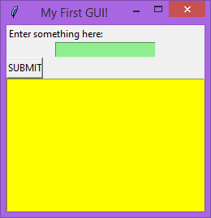
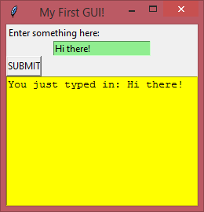
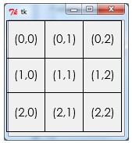
GUI Building with TKinter
Lesson 5 – counting & viewing entries in a text file

Slide 2


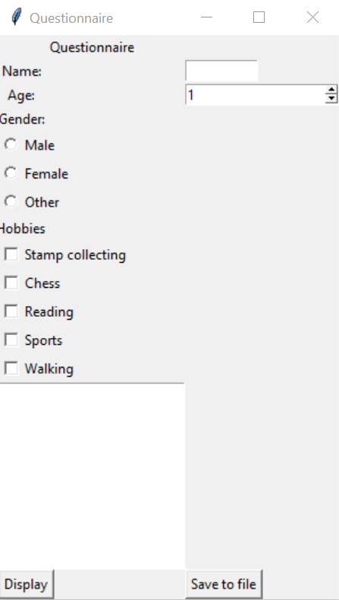
Activity 1
Load the lesson 4 activity 3 code you made last lesson, or download a copy of the “lesson 4 activity 3 solution” code from Google Classroom

Slide 3
Today’s lesson
Introduction
Last lesson you learned the preferred method of the WJEC for writing data out to a text file, using spaces to make a table. The next new thing you have to learn is how to count and view entries based on a condition given by the user – e.g. count how many people have selected “stamp collecting” as a hobby, or how many people are called “Bob”.
Learning Objectives:
Understand how to count and view entries in a text file based on user entered criteria

Slide 4
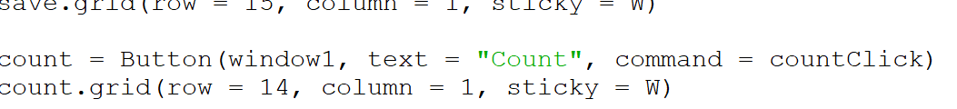

Tkinter – counting entries
The first thing we’re going to need is a new button called “count”. Add the code for this new button after the save button code, and create a new function above the saveClick function called countClick.

Slide 5
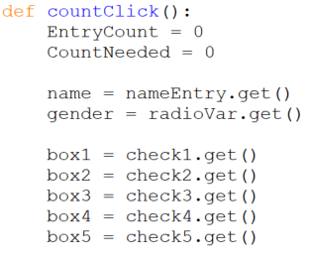
Tkinter – counting entries
The start of the countClick function is similar to the other two we’ve made, although this one needs two new variables at the top which we’ll use later on.
Keeps track of how many entries we’ve found which match the criteria
Keeps track of how many different criteria have been entered
e.g. if the user has entered a name, an age and selected “chess” as a hobby, there are 3 things we are searching for and CountNeeded would be set as 3 later on
Notice that we are not getting the value for age this time – we could include age in our counting but it would require additional code elsewhere, so we’ll just keep things simple for now.

Slide 6
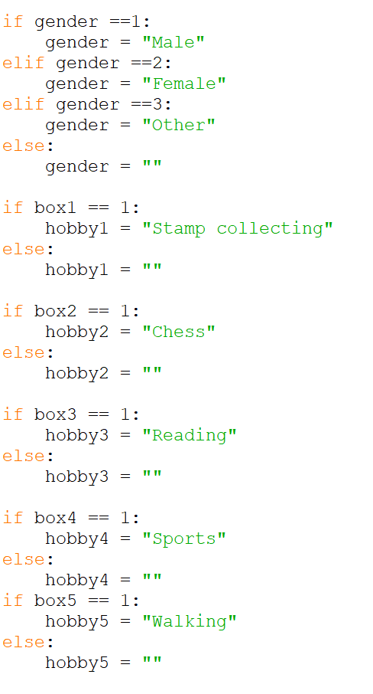
Tkinter – counting entries
Like we did with the save code last lesson, we need to handle the integer input of the radio button and check boxes using if statements.
This part is slightly different this time – we need gender to be empty if nothing has been selected.

Slide 7
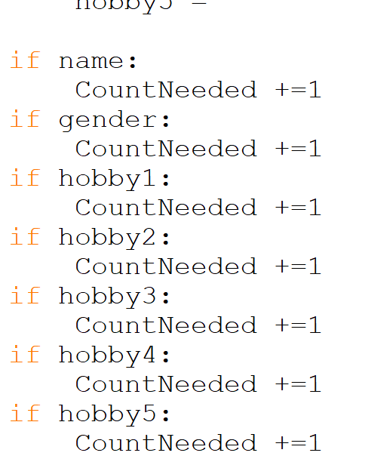
Tkinter – counting entries
Next we need some if statements to check if the user has actually entered some criteria to count.
For each of the criteria we are checking, if something has been entered or selected then we increase CountNeeded by 1.
If nothing has been entered or selected, CountNeeded will remain at 0.
This is the same as saying
If there is something in hobby 4

Slide 8
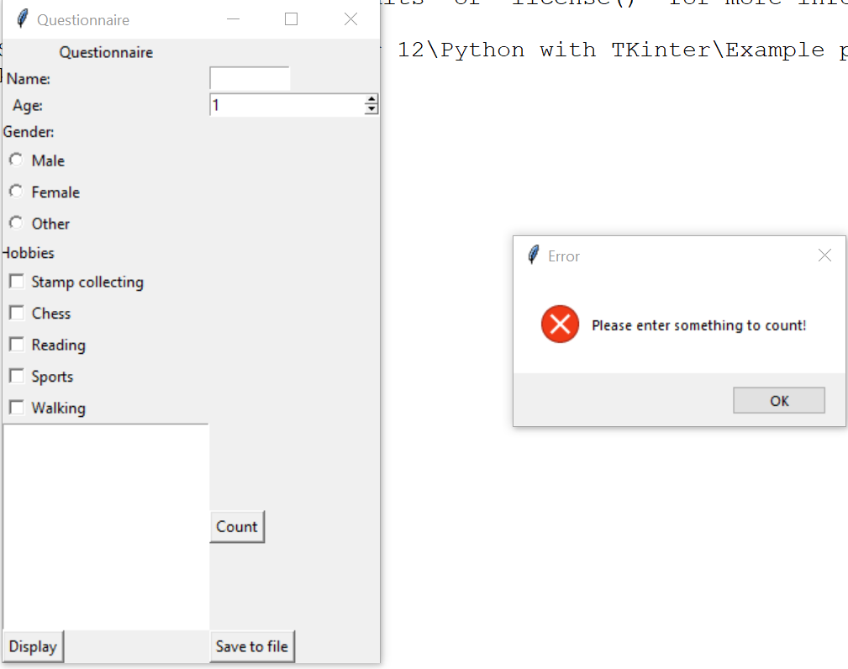
Tkinter – counting entries
We want to output a message to the user if they have not entered anything to let them know this. We could use Python’s usual print() function, but the user might not know where to look for the output.
A better solution would be to have a message box pop up, something like this:

Slide 9

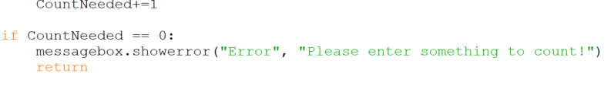
Tkinter – counting entries
In order to implement a message box, we need to import the library at the top of the code like so:
Now we can add in some code in our countClick function to show an error if the CountNeeded variable still has a value of 0:
Return will end the function prematurely – we don’t want to carry on if the user hasn’t entered anything

Slide 10
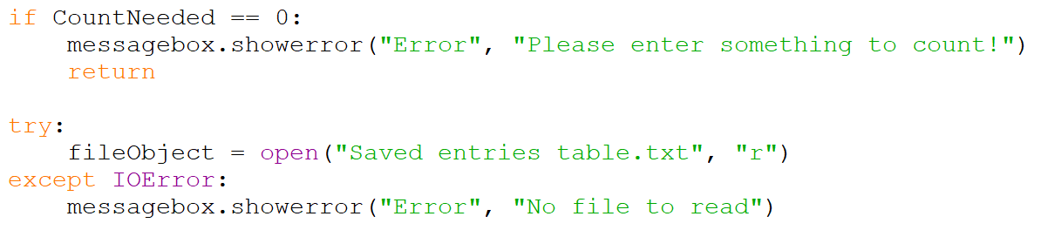
Tkinter – counting entries
Next let’s use try except to attempt to open the saved entries table in read mode so that we can access the data.
In the past we’ve just used except – adding IOError just tells Python what error we are specifically expecting. There are other types of error which we will be looking at later on when we do validation.
Make sure the “try” line is on the same indent level as the “if” statement above it – all of this new code is still inside the countClick function.

Slide 11
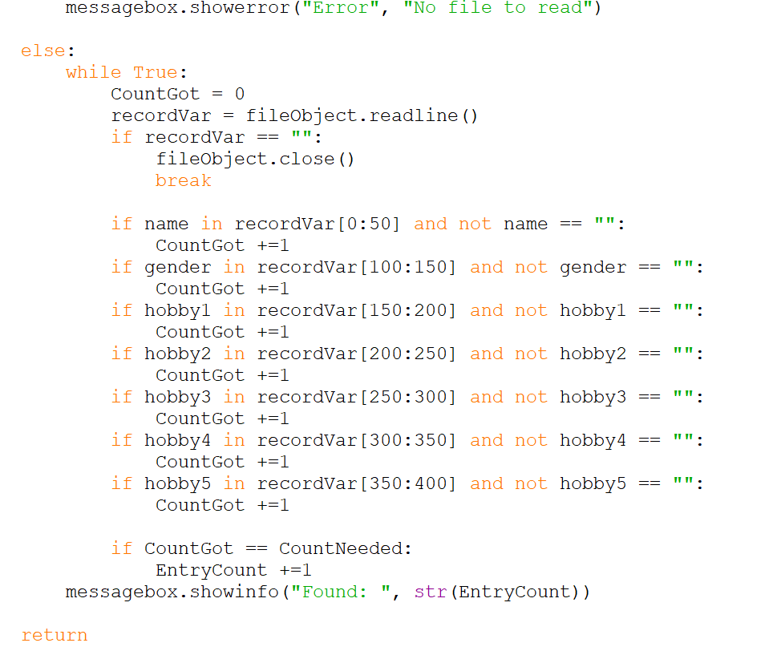
Tkinter – counting entries
Now we can type the remaining code for the counting function in.
This “else” is on the same indent line as the “try” and “except”. It will happen if the “try” part is successful.
We start a while loop here for reading through the file.
CountGot will keep track of any matches we find for the things we’re looking for.
.readline() reads a single line of the textfile, storing it in the recordVar variable. This basically means we are looking at a single record each time the while loop goes round.
Checks to see if the line we’re currently looking at is empty. If so that means we’ve reached the end of the file and we can break out of the loop.
These next 14 lines check to see if the criteria are present in the current line of the file. The recordVar[0:50] means checking the first 50 characters, recordVar[100:150] checks the characters between 100 and 150 and so on.
We’ve missed out [50:100] intentionally because that’s where the age data is stored.
Checks to see if the number of criteria that match equals the number of criteria that were entered by the user.
Display to the user how many were found, even if it’s 0

Slide 12
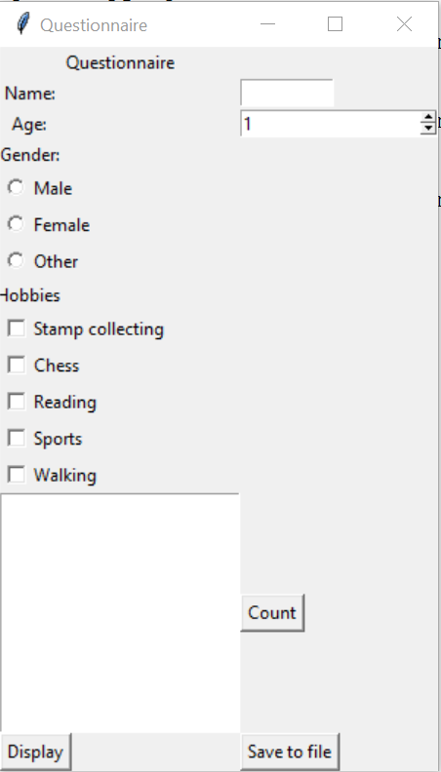
Activity 2
Add the count button to your window, and the code necessary to count the entries that match the user’s criteria.
Save your work as “lesson 5 activity 2”.

Slide 13
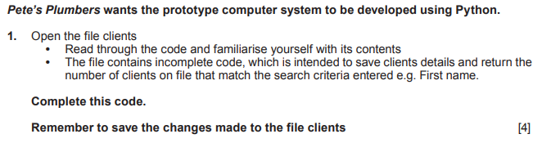
Tkinter – counting entries
Now you’ve seen the WJECs preferred method of file saving and counting entries, let’s have a look at a past paper question.
The question refers to a Python file called “Clients.py”. Download this file from the Google Classroom assignment and open it.
Don’t run the code yet however – there are some missing parts that you need to fill in.

Slide 14
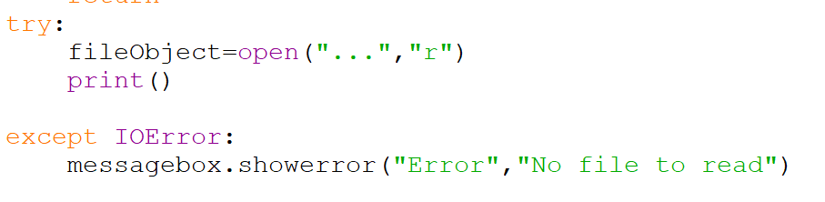
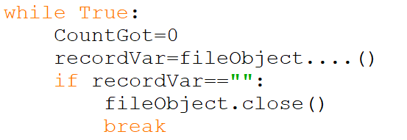
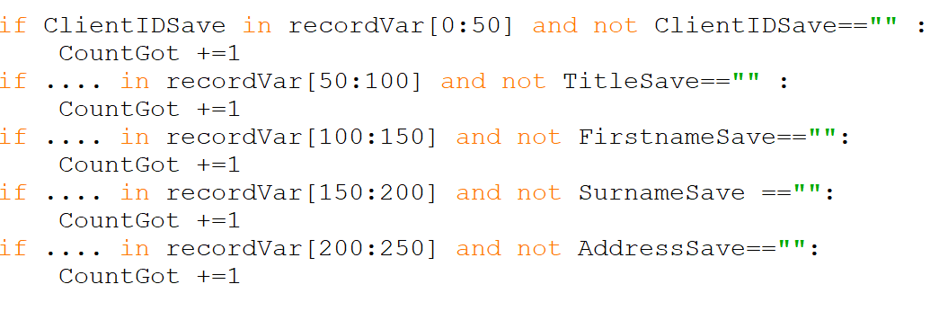

Tkinter – counting entries
Find the countClient function. There are 4 sections of this function where there is missing code, identified with a number of dots…

Slide 15
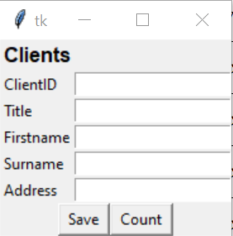
Activity 3
Using the code you’ve done in activity 2 as a guide, complete the missing sections of the countClient function.
Save your work as “lesson 5 activity 3”.

Slide 16
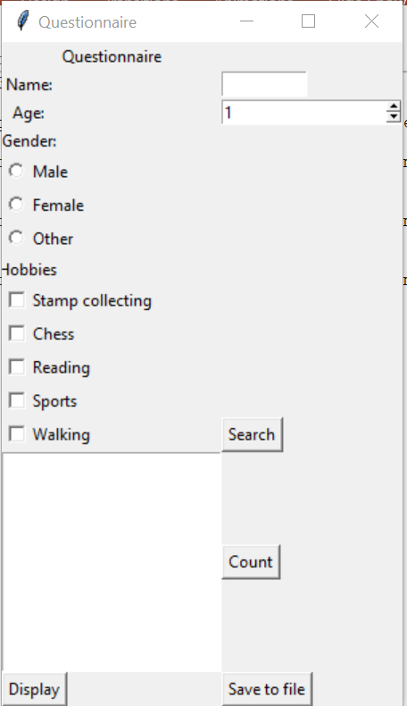
Tkinter – viewing entries
It may be necessary to view the data relating to a name that is searched. We need to make some small changes to the count code to allow us to do this.
Load the code from activity 2, then add a new button to the UI called “search” which appears on the form like so:
For the searchClick function accompanying the button, copy and paste the code in the countClick function for now.

Slide 17
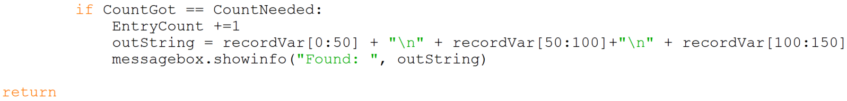
Tkinter – viewing entries
The code for viewing records is more or less the same as the count function, except for the last few lines of the function.
Scroll down to the end of the function, and alter the last lines so that they now look like this:
These 3 parts of the recordVar will contain the name, age and gender of the person. You can add more to this line so that it also outputs their hobbies as well.

Slide 18
Tkinter – viewing entries
The way we’ve done that code means that you can search for people using any of the inputs like name, gender or hobby.
Make sure when you test the code you try several different variations – e.g. several entries with the same name, some with the same age, some with different hobbies.

Slide 19
Activity 4
Using the code you’ve done in activity 2 as a guide, complete the missing sections of the countClient function.
Save your work as “lesson 5 activity 4”.

Slide 20
Uploading your work
You should now have 3 complete Python files from today’s lesson (plus any extension work). On Google classroom you will find an assignment for this lesson, and you need to upload your completed Python file to this assignment.
If you have any problems doing this, please speak to your teacher.

